Slide 1

Research Question – Tutorial Presentation for Feedback Date: 18-11-2024
7COM1079-2024 Student Group No: A 177
Group Name: A 177 Name of Student Presenting: Roshwin Johny

Slide 2
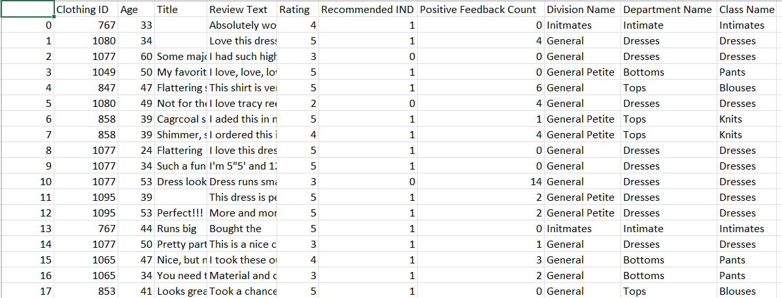
> Our dataset has 23486 Rows

Slide 3
Our Independent variable is: AGE ("young" and "old“) This Independent variable datatype is : Nominal Our Dependent variable is: RATING ( "highly rated" and "low-rated") This Dependent variable datatype is : Nominal
Dataset ID – DS 147 Women's E-Commerce Clothing Reviews (kaggle.com)
This dataset is interesting to us because : This dataset is interesting because as a teenager and being a part of a significant consumer demographic,analysing this data helps us to understand how our generations opinion differ from older ones.
Notes:
Before specifying your Research Question you must define the type of data you are analysing. Are the variables you select interval data (measurement data you can divide, multiple, etc), OR are they ordinal (there is a definite order but the intervals between each variable are not necessarily equal, or the terms might be subjective like in a likert scale); OR are they just categorical/nominal (Items such as film names, cities, etc., that you can count numbers of occurrences? You also need to understand whether the variable is either dependent or independent and this will vary according to the context. Independent variables may cause an effect, whereas the dependent variable might be effected by the independent variable. Check the lecture notes on the RQ for more information and examples.
You will get only one opportunity to present your Research Question ahead of the submission date. Have your questions ready, and be ready to take notes on feedback.

Slide 4
Our Research Question is
"Is there a difference in the proportion of highly rated products (Rating) between young and old women (Age) ?

Slide 5
1. Null hypothesis (H₀):
There is no difference in the proportions of highly rated products (Rating) between young and old women (Age).
2. Alternative hypothesis (H₁):
There is difference in the proportions of highly rated products (Rating) between young and old women (Age).

